Slide 1

Combining optimal control and learning for visual navigation in novel environment
2020RNE

Slide 2
5 Simulation Experiments
張軍斌

Slide 3
Compare methods
LB-WayPtNav
Combining classical optimal control with learning for interpreting images.
E2E learning
Ignoring all knowledge about the known system.
Geometric mapping and path planning
No learning.

Slide 4
Simulation Setup
From scans of real world buildings (from the Stanford large-scale 3D Indoor Spaces dataset ).
Scans from 2 buildings
185 test episodes (start, goal position pairs)
Scenarios such as: going around obstacles, going out of the room, going from one hallway to another.

Slide 5
Metrics
Success rate
If the robot reaches within 0.3m of the goal position without any collisions.
Average time to reach the goal
The successful episodes.
Average acceleration
Jerk along the robot trajectory
Measure execution smoothness and efficiency with respect to time and power.

Slide 6
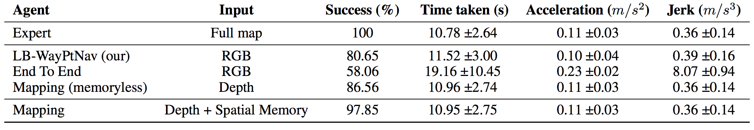
Comparison with the End-to-End learning approach
Table 1. Quantitative Comparisons in Simulation
To the goal location more often (22% higher success rate)
Much faster (40% less time to reach the goal)
Less power consumption (50% less acceleration).

Slide 7
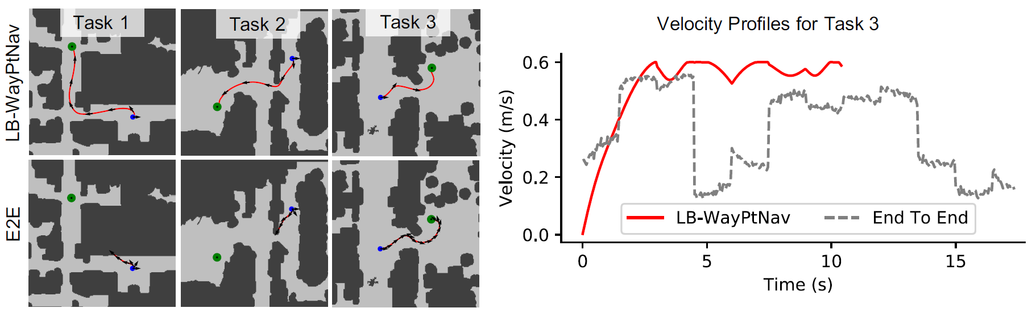
Comparison with the End-to-End learning approach
LB-WayPtNav is able to successfully navigate through narrow hallways, and make tight turns around obstacles and corners, while E2E method struggles.
Figure 2. Trajectory Visualization

Slide 8
Comparison with the End-to-End learning approach
Both approaches are able to reach the target position for task 3, LB-WayPtNav takes only 10s to reach the target whereas the E2E learning approach takes about 17s.
Figure 2. Trajectory Visualization

Slide 9
Comparison with Geometric Mapping and Planning Approach
When used with ideal depth image observations, achieves near expert performance.
Even though the performance of memory-less planner is comparable to LB-WayPtNav. However, since real-world depth sensors are neither perfect nor have an unlimited range.
Table 1. Quantitative Comparisons in Simulation

Slide 10
Visualization of Learned Navigation Affordances
LB-WayPtNav is able to learn the appropriate navigation cues, such as entering the room through the doorway for a goal inside the room, continuing down the hallway for a farther goal. Such cues enable the robot to navigate efficiently in novel environments.
Figure 3. Two related navigation tasks where the robot is initialized in the same state, but is tasked to either go inside a close by room (Case A), or to a far away room that is further down the hallway (Case B).

Slide 11
Visualization of Learned Navigation Affordances
LB-WayPtNav focuses on the walls, doorways, hallways and obstacles such as trash-cans as it predicts the next waypoint, and what the network attends to depends on where the robot is trying to go.
Figure 3. Two related navigation tasks where the robot is initialized in the same state, but is tasked to either go inside a close by room (Case A), or to a far away room that is further down the hallway (Case B).

Slide 12
6 Hardware Experiments
張軍斌

Slide 13
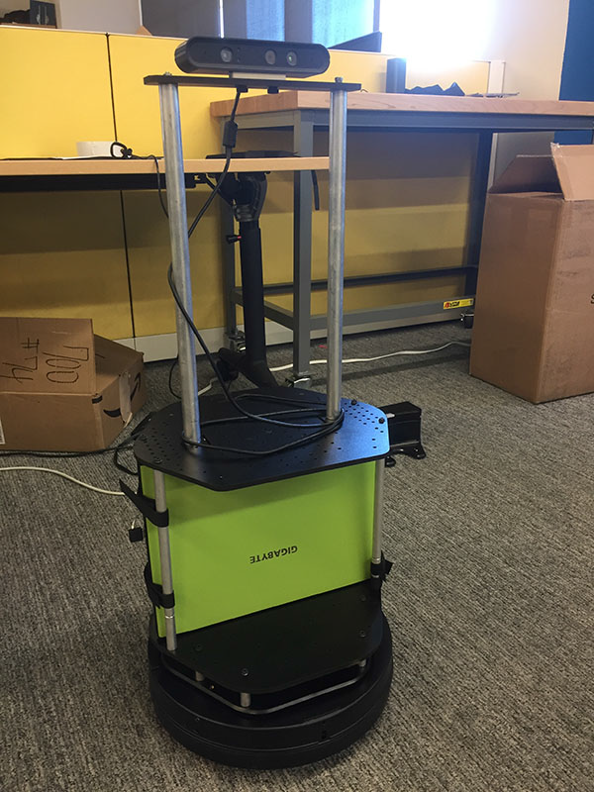
Hardware Experiments
TurtleBot 2 hardware
Use the network trained in simulation and deploy it directly on the TurtleBot without any additional training or finetuning.
Tested the robot in two different buildings, neither of which is in the training dataset (in fact, not even in the S3DIS dataset).
Figure 11. Our Turtlebot 2 hardware platform uses a Yujin Kobuki base, Gigabyte Aero Laptop, and Orbbec Astra camera.

Slide 14
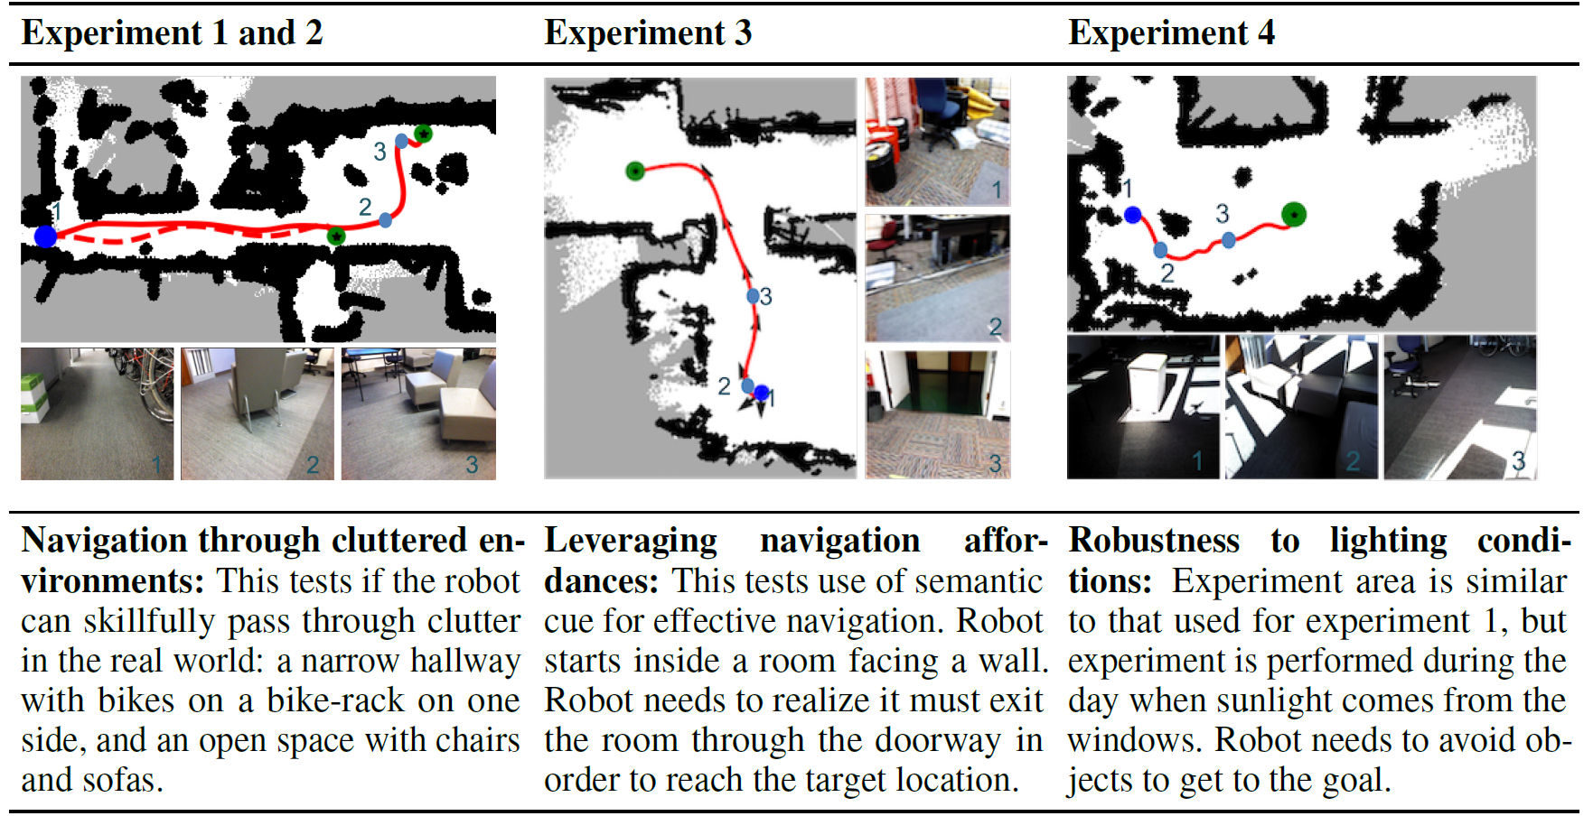
Experiment setups
Table 2. Experiment setups, with top-views (obtained offline only for visualization), and sample images. Robot starts at the blue dot, and has to arrive at the green dot. Path taken by LB-WayPtNav is shown in red.

Slide 15
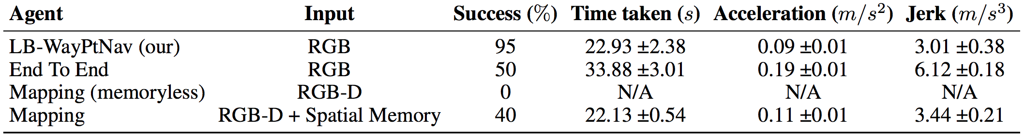
Comparison to Geometric Mapping and Planning
While LB-WayPtNav is able to solve 95% of the trials, this memory-less baseline completely fails. It tends to convey the robot too close to obstacles, and fails to recover.
In comparison, the map building scheme performs better, with a 40% success rate.
Table 3. Quantitative Comparisons for Hardware Experiments

Slide 16
Comparison to Geometric Mapping and Planning
The reason for this poor performance, and found that this is largely due to imperfections in depth measurements in the real world.
For example, the depth sensor fails to pick-up shiny bike-frames and helmets, black bike-tires and monitor screens, and thin chair legs and power strips on the floor.
Table 3. Quantitative Comparisons for Hardware Experiments

Slide 17
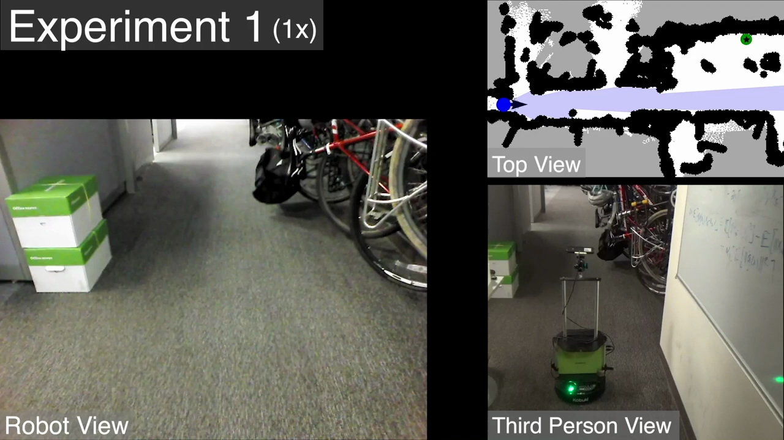
Performance of LB-WayPtNav
LB-WayPtNav is able to precisely control the robot through narrow hallways with obstacles (as in experiment 1 and 2) while maintaining a smooth trajectory at all times.
This is particularly striking, as the dynamics model used in simulation is only a crude approximation of the physics of a real robot (it does not include any mass and inertia effects, for example).
Experiment 1

Slide 18
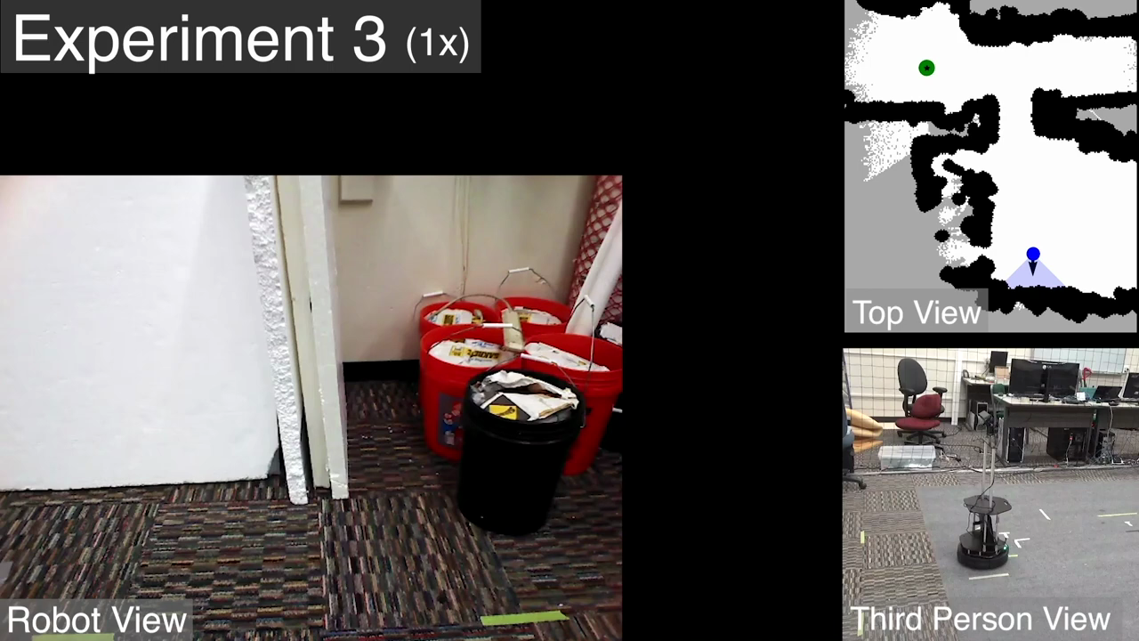
Performance of LB-WayPtNav
LB-WayPtNav also successfully leverages navigation cues (in experiment 3 when it exits the room through a doorway), even when such a behavior was never hard-coded.
Experiment 3

Slide 19
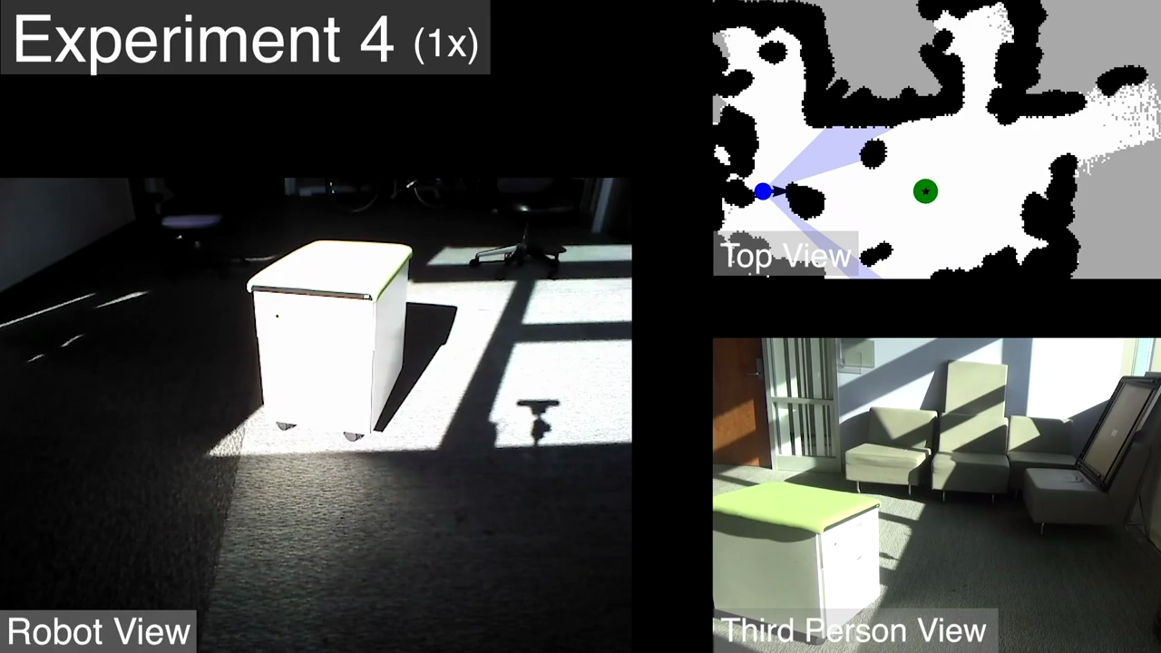
Performance of LB-WayPtNav
Data augmentation
LB-WayPtNav is able to perform well even under extreme lighting conditions as in Experiment 4.
Experiment 4

Slide 20
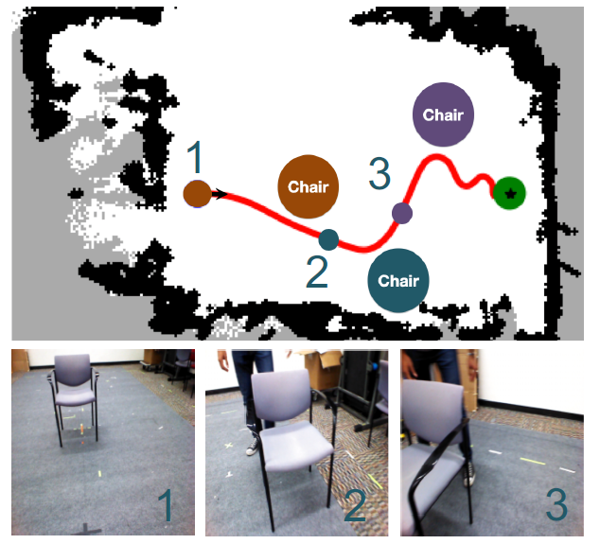
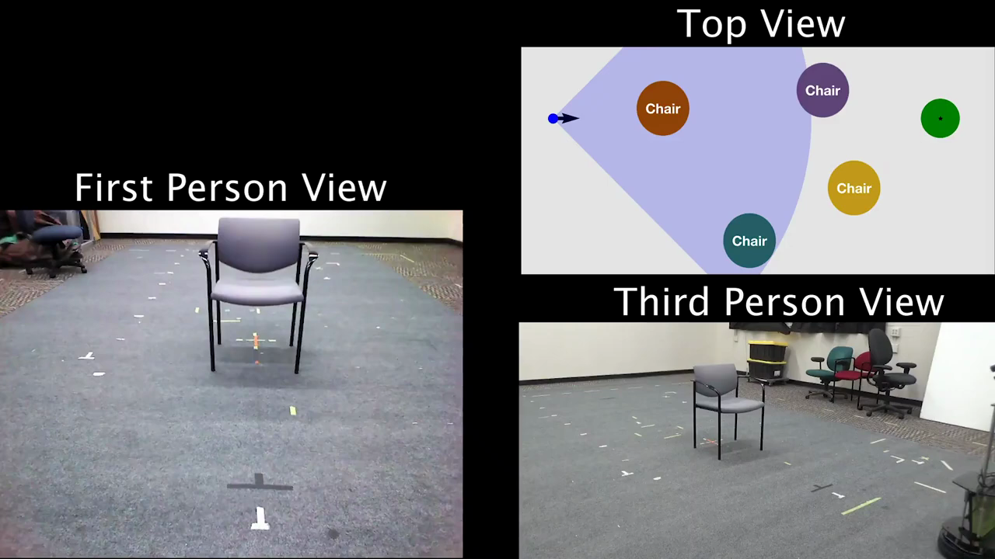
Performance of LB-WayPtNav
LB-WayPtNav can adapt to changes in the environment.
The robot’s goal is to go straight 6m. It must go around the brown chair.
The robot successfully reacts to the moving obstacle and reaches the target without colliding.
Experiment 5

Slide 21
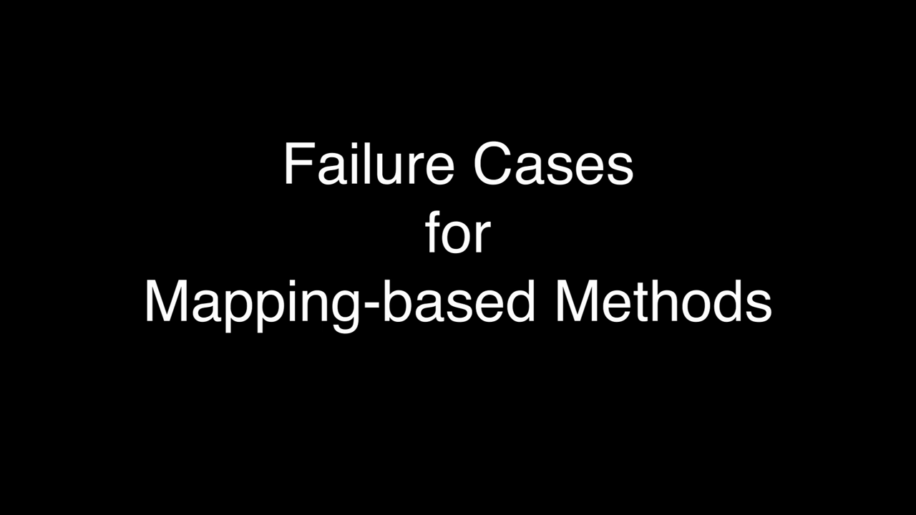
Failure Modes of End-to-End and Mapping-Based Methods

Slide 22
7 Discussion
AAA

Slide 23
7 Discussion
P

